Slide 1
Optimizing Quantization for Better Compression
Exploring Sparsity and zstd Compression Improvements
Your Name & Date

Slide 2
Background & Motivation
• Model compression is essential for efficiency in resource-constrained environments.
• Standard methods include quantization, pruning, and entropy-based compression like zstd.
• The Problem: Does increasing zeros in quantized weights improve zstd compression?
• Goal: Validate assumptions and explore alternative strategies for compression improvement.

Slide 3
Experiment 1 – Adjusting Min-Max Clipping for Sparsity
• Objective: Determine if modifying min-max clipping increases sparsity in quantized weights.
• Method: Implemented per-layer visualization tools in Jupyter Notebook for dynamic min-max adjustments.
• Result: Successfully increased the number of zeros in the quantized weight matrices.

Slide 4
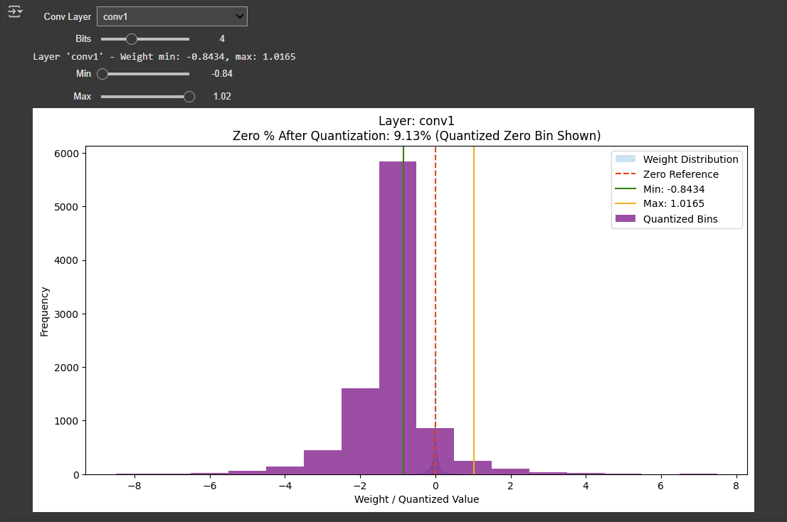

Slide 5
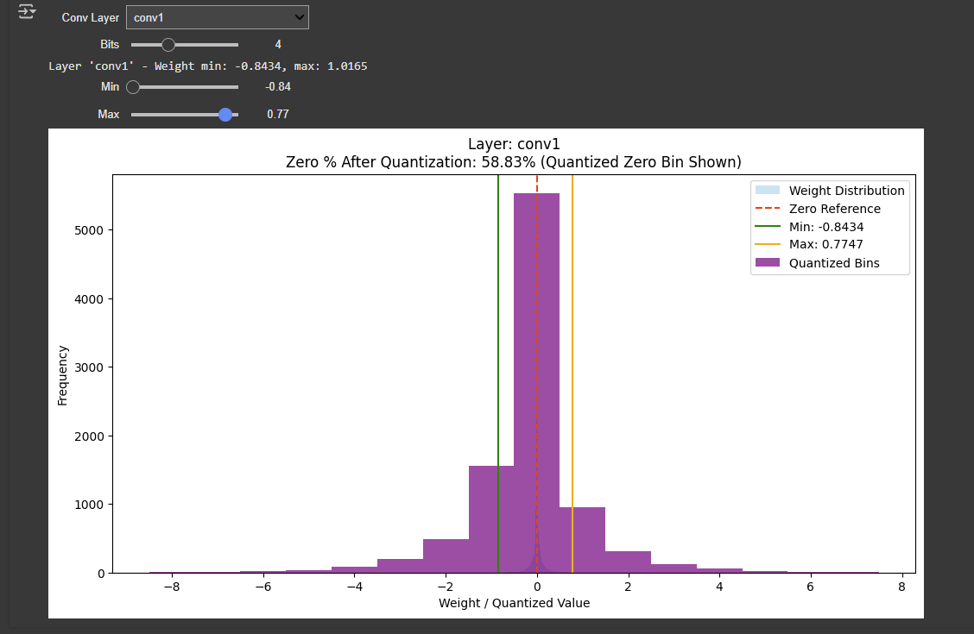

Slide 6
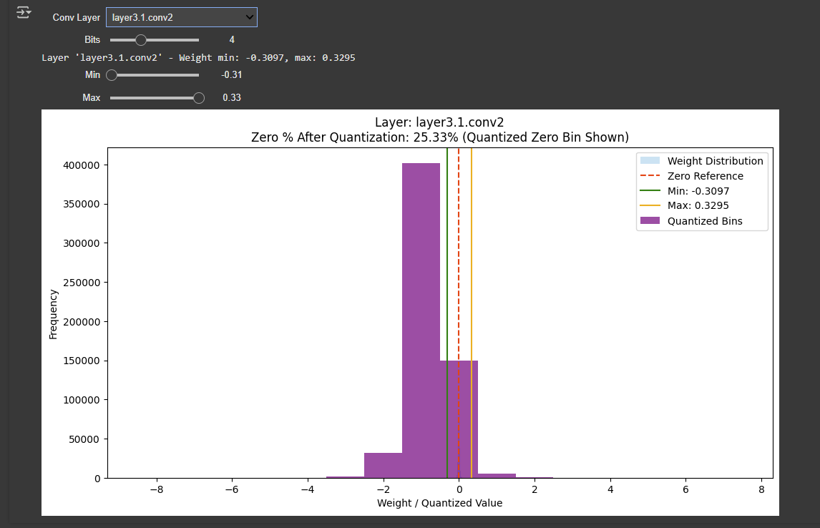

Slide 7
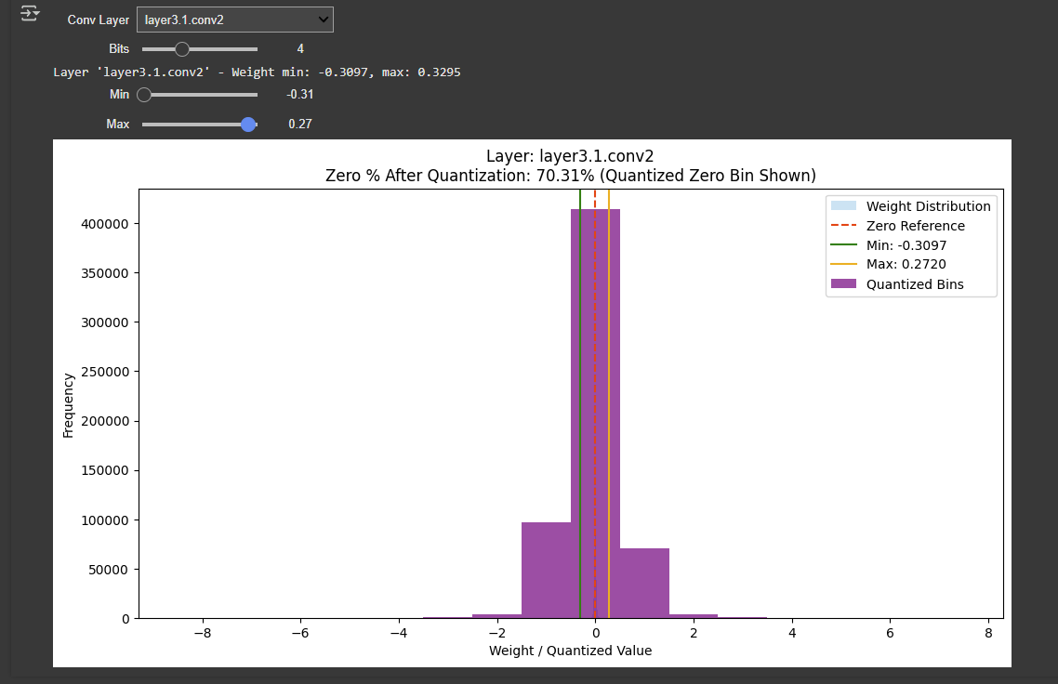

Slide 8
Experiment 2 – Checking zstd Compression vs. Zeros
• Hypothesis: Higher sparsity improves zstd compression.
• Method: Conducted grid search to maximize sparsity and evaluated compression ratios.
• Result: Despite increasing zeros, zstd compression did not improve.

Slide 9
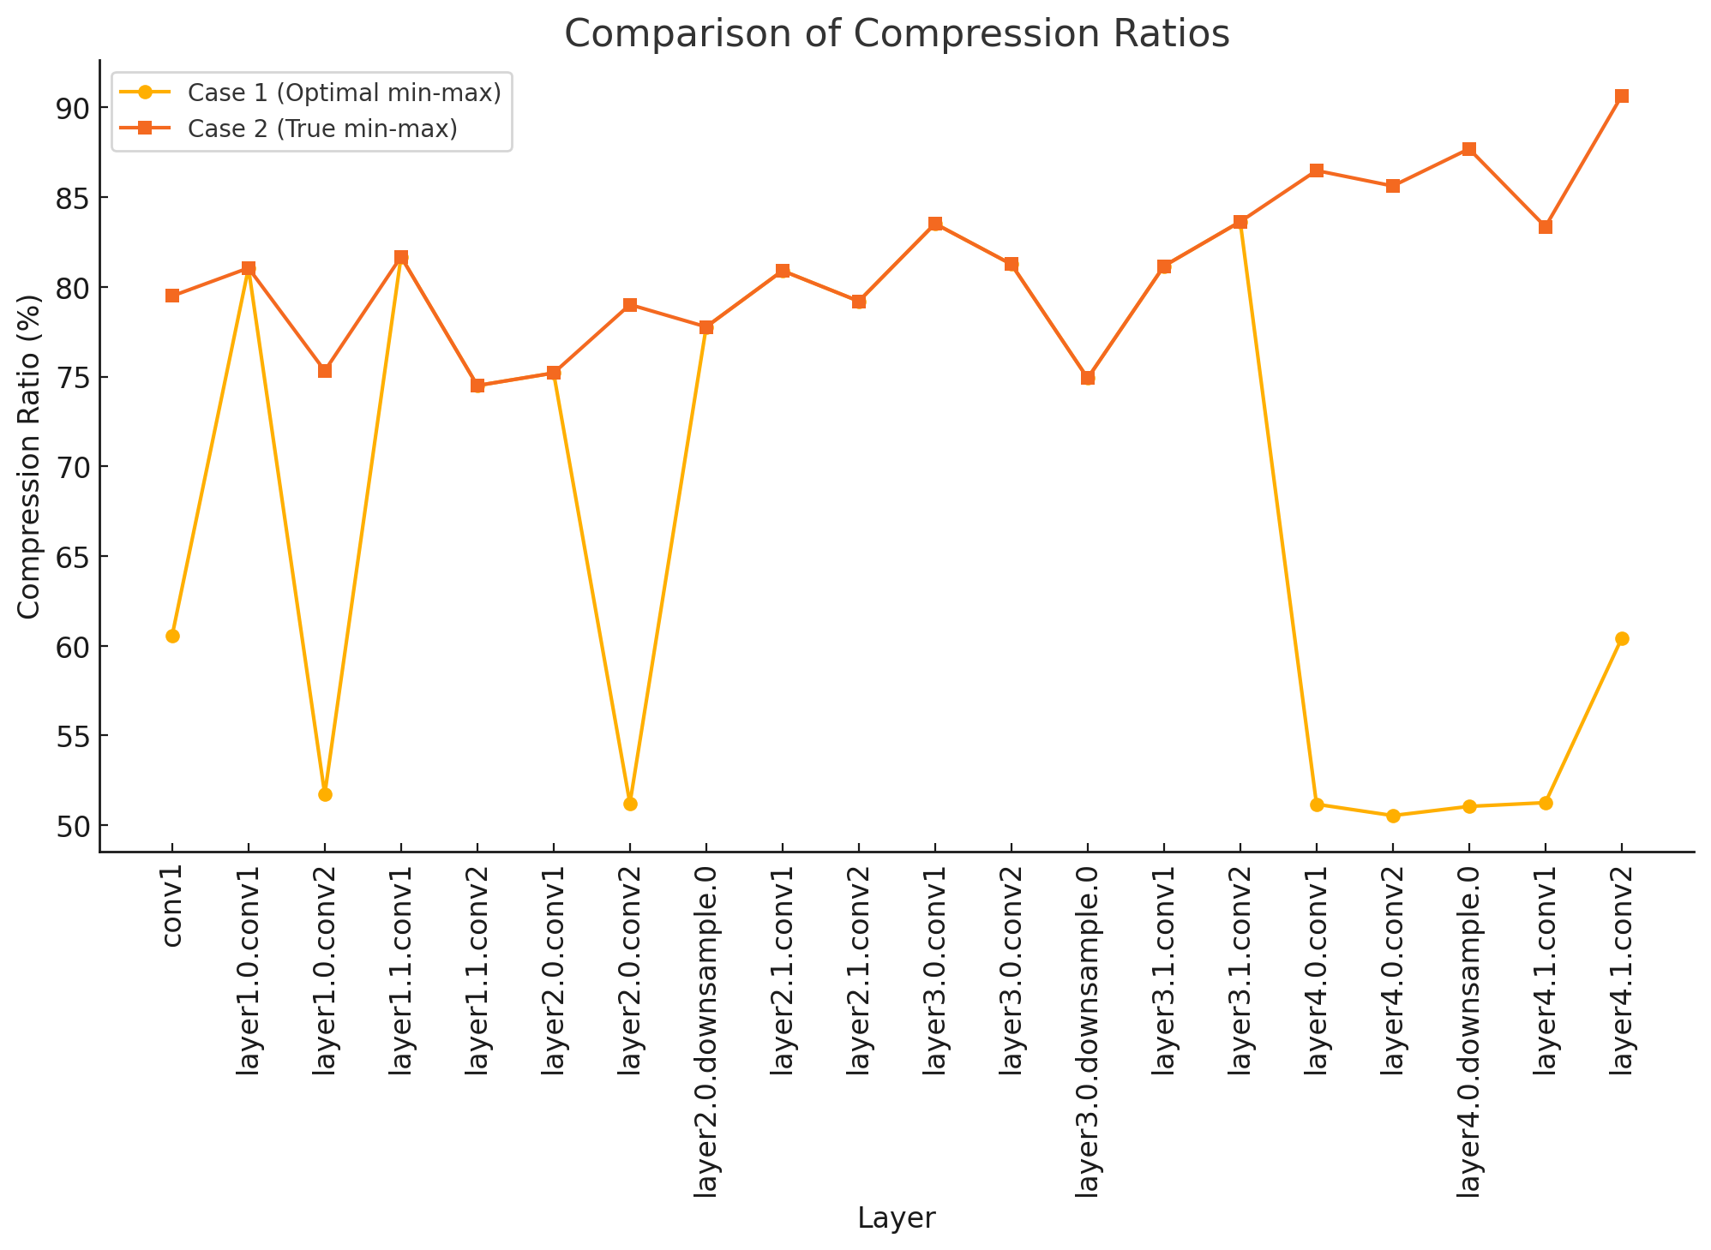
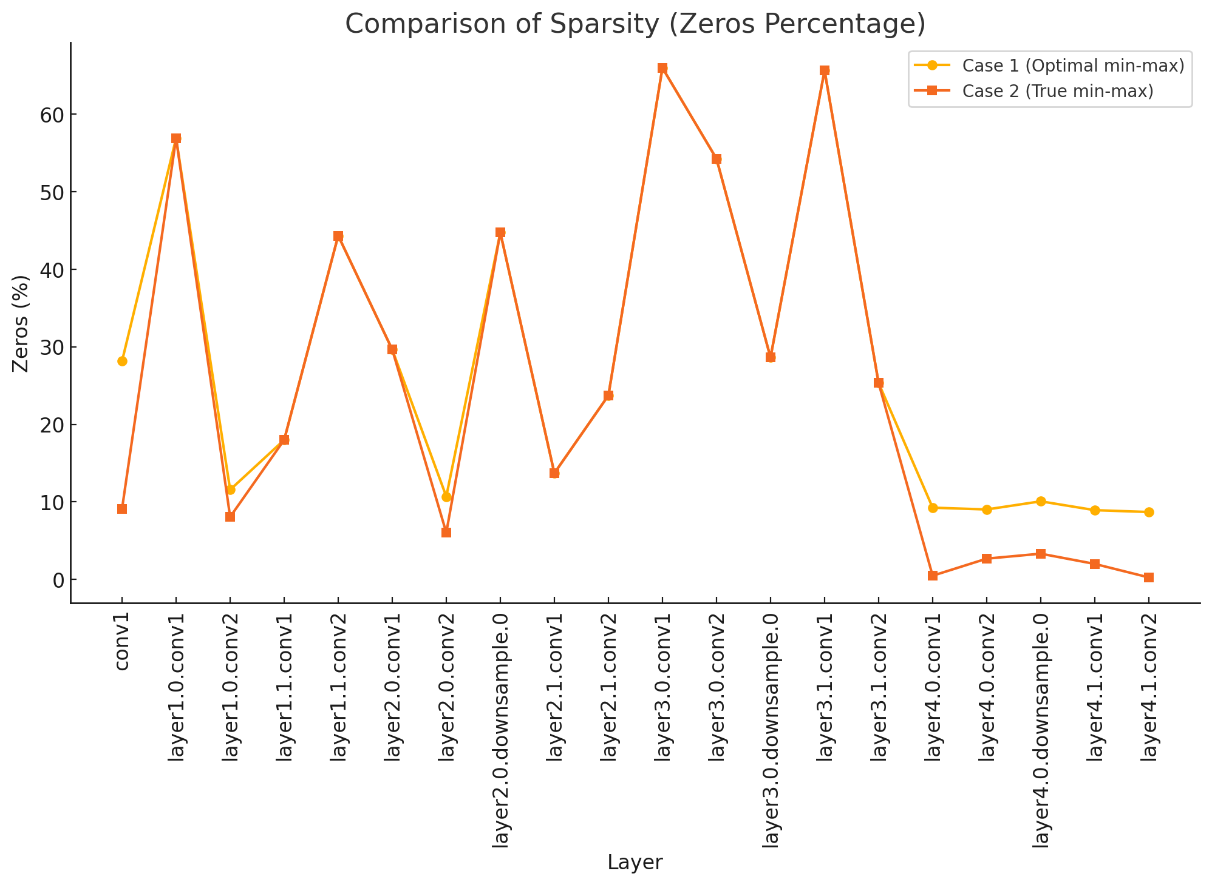

Slide 10
Case 1 (Optimal Min-Max for Increased Sparsity)
Shows a significant increase in sparsity for most layers.
Compression ratio, however, does not show a clear advantage.
Case 2 (True Min-Max)
Less sparsity in certain layers, but the compression ratio is often higher.
Indicates that sparsity alone does not guarantee better compression with zstd.
Key observations:
Higher sparsity does not always correlate with higher compression efficiency in zstd.
Certain layers benefit more from sparsity than others, likely due to weight distribution and entropy in compression.
An alternative approach may be needed—either modifying zstd to exploit sparsity or using an additional compression step.

Slide 11
Key Takeaways from Experiments
• More zeros ≠ better zstd compression.
• Compression gains require different quantization or compression techniques.
• Next Steps: Explore alternate strategies for optimizing both sparsity and compression.

Slide 12
Future Directions – Optimizing Quantization Strategy
• Idea: Use Evolutionary Algorithms / Bayesian Optimization to optimize for accuracy + compression.
• Initial Finding: Grid search showed potential; next step is full optimization with accuracy in focus.

Slide 13
Future Directions – Post-Quantization Compression Techniques
• Idea: Maintain zero-increasing quantization but introduce Run-Length Encoding (RLE).
• Experiment Status: Ongoing tests integrating RLE with zstd.
• Expected Benefit: Additional compression for structured sparsity.

Slide 14
Future Directions – Modifying zstd for Sparsity Awareness
• Challenge: zstd does not inherently benefit from zeros.
• Solution Idea: Modify zstd parameters or entropy coding to exploit sparsity.
• Next Steps: Deeper analysis into zstd compression behavior.

Slide 15
Next Steps & Implementation Plan
1. Complete RLE + zstd experiments.
2. Develop an automated Bayesian/Evolutionary optimization framework.
3. Research ways to enhance zstd for sparsity-aware compression.
4. Evaluate accuracy trade-offs and overall impact.

Slide 16
Conclusion
• Summary of key insights.
• Next research direction.
• Discussion and Q&A.

